Slide 1



Vital sign measurement system
Blood oximeter and body temperature
Presented by:
M. Chaitanya kumar(CSE)
J. Vaishnavi(CSE)
L. Rishika(CSE)
G. Narayana swami(ECE)

Slide 2
Abstract
Consistent vital sign monitoring is critically important for early detection of clinical deterioration of patients in hospital settings. Mostly, nurses routinely measure and document the primary vital signs of all patients 2‐3 times daily to assess their condition. To reduce nurse workload and thereby improve quality of patient care, a smart vital sign monitor named “Vital‐SCOPE” for simultaneous measurement of vital signs was developed. Vital-SCOPE consists of multiple sensors, including a reflective photo sensor, thermopile, and medical radar, to be used in simultaneous pulse rate, respiratory rate, and body temperature monitoring within 10 s.

Slide 3
Introduction
Vital signs are measurements of the body’s most basic functions. The four main vital signs routinely monitored by medical professionals and health care providers include the following:
Body temperature
Pulse rate
Respiration rate (rate of breathing)
Vital signs are useful in detecting or monitoring medical problems. Vital signs can be measured in a medical setting, at home , at the site of a medical emergency, or else where.

Slide 4
Importance of vital signs
Your vital signs measure your body’s basic functions. Vital display a snapshot of what’s going on inside your body . They provide crucial information about your organs. Therefore, the importance of vital signs monitoring is that it allows medical professionals to assess your wellbeing

Slide 5
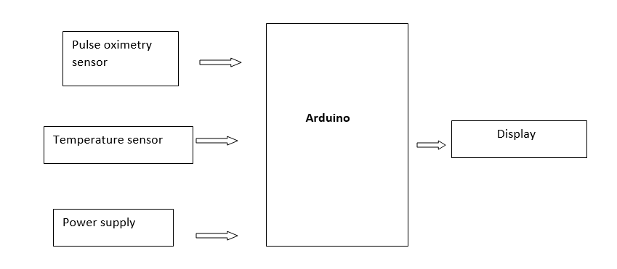
Block diagram

Slide 6
components
Arduino mega 2560
16x2 LCD
Max30102 Heart Rate Sensor
Bread board
Resistors
Jumper wires
LM35 temperature sensor

Slide 7
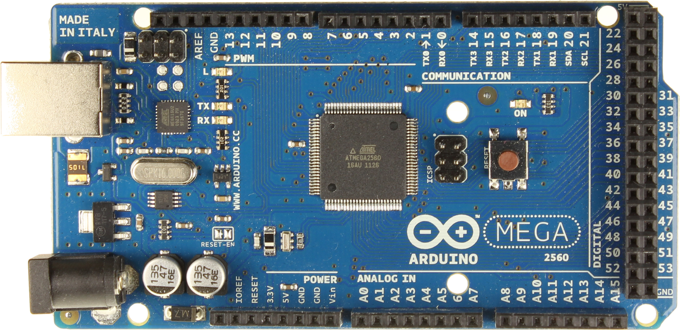
Arduino mega 2560
Arduino: Arduino Mega 2560 is a microcontroller board based on the ATmega328p . It has 14 digital input/output pins (of which 6 can be used as PWM outputs), 6 analog inputs.
A USB connection, a power jack, an ICSP header and a reset button.

Slide 8
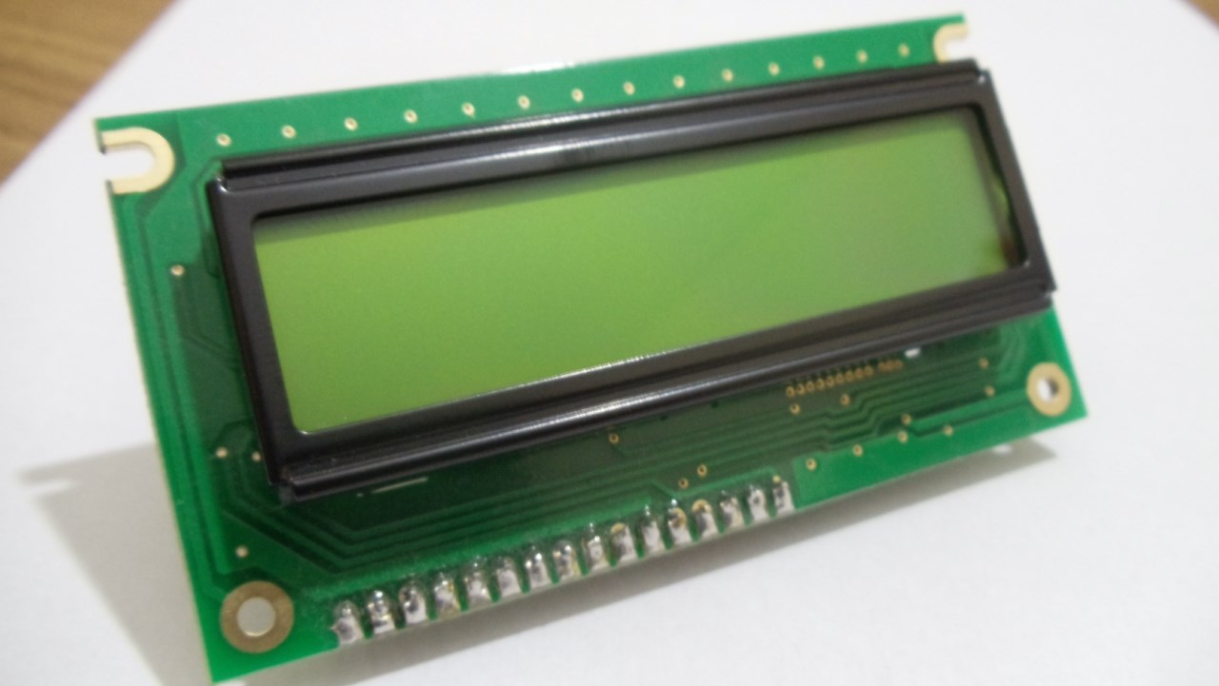
Lcd display
An LCD is an electronic display module that uses liquid crystal to produce a visible image. The 16 x 2 LCD display is a very basic module commonly used in DIYs and circuits. The 16 x 2 LCD translates a display 20 columns of characters per 4 rows .

Slide 9
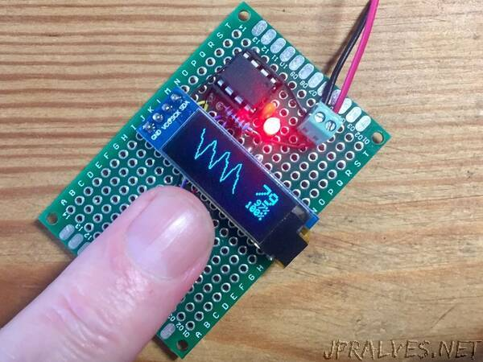
Heart Rate Sensor (Max30102)
The Max30102 is an integrated pulse oximeter (SpO2)
And heart rate monitor biosensor module .
It provides a complete system solutions to ease the design in process for mobile and wearable devices.

Slide 10
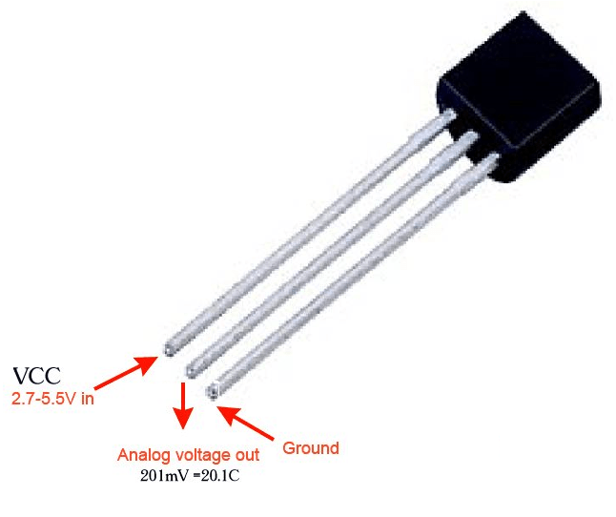
lm35 Temperature Sensor
The LM35 series are precision integrated-circuit temperature devices with an output voltage linearly proportional to the Centigrade temperature. The LM35 device has an advantage over linear temperature sensors calibrated in Kelvin, as the user is not required to subtract a large constant voltage from the output to obtain convenient Centigrade scaling. The LM35 device does not require any external calibration or trimming to provide typical accuracies of ±¼°C at room temperature and ±¾°C over a full −55°C to 150°C temperature range. Lower cost is assured by trimming and calibration at the wafer level

Slide 11
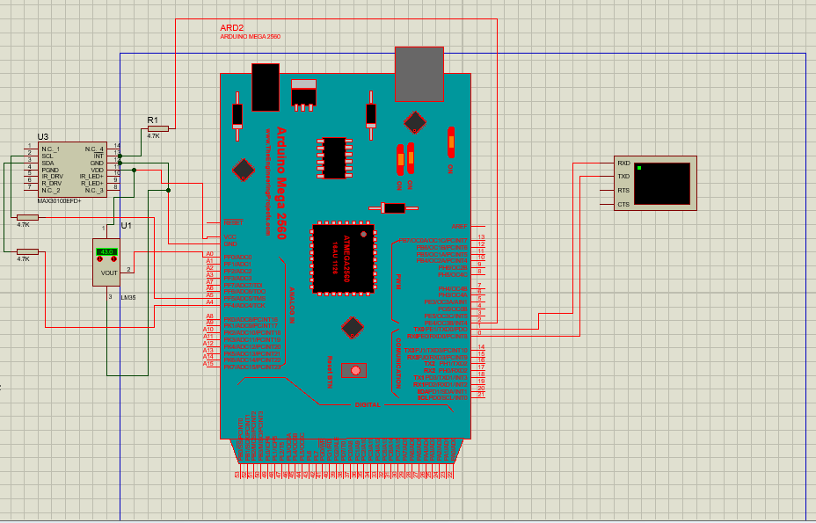
Circuit:

Slide 12
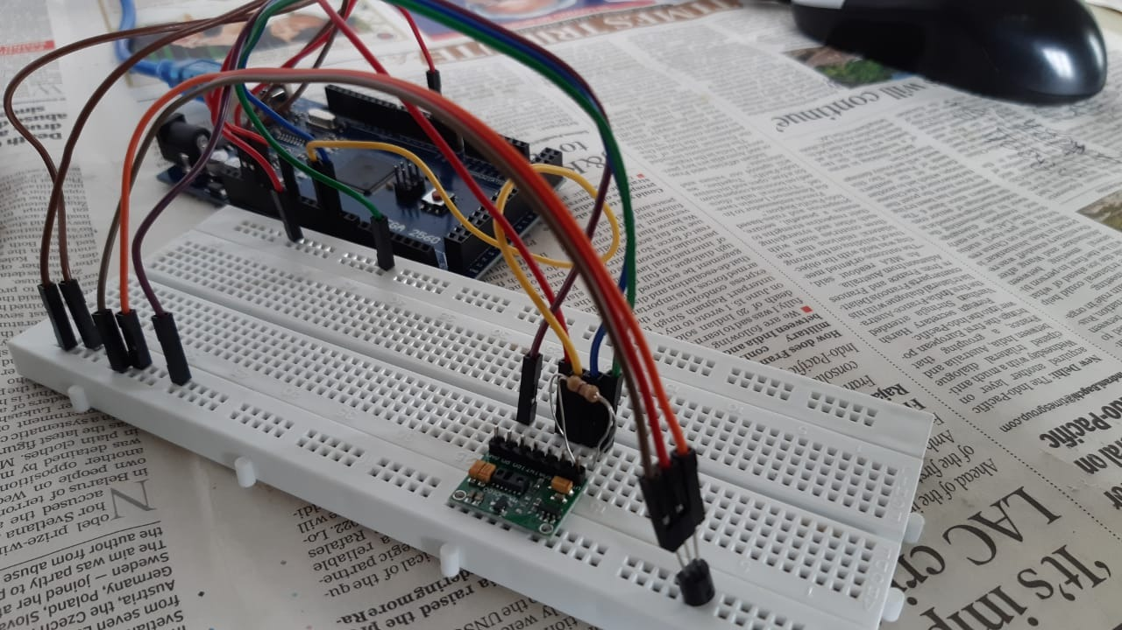
Project

Slide 13
FUTURE SCOPE
In future, heart rate and respiration rate can also be measured by pulse oximeter along with SpO2 providing further functionality to the project. Also, different sensors like blood pressure sensor and ECG sensor can be added to measure other parameters as well. Further, by integrating GSM with our project, we can send notiﬁcation messages to a medical expert helping in immediate alert in case of emergencies. Provision of information regarding prescription and reminder for medicine intake can also be included.

Slide 14
Budget Estimation
Arduino mega 2560 – 1000/-
16x2 LCD – 120 /-
Max30102 Heart Rate Sensor – 450 /-
Jumper wires-100/
Resistors – 30 /-
Bread board-150/
LM35 Temperature Sensor Module – 100 /-
TOTAL BUDGET – 1950/-

Slide 15
Thank you

